Slide 1
Digital exclusion and older people’s access to health services

Slide 2
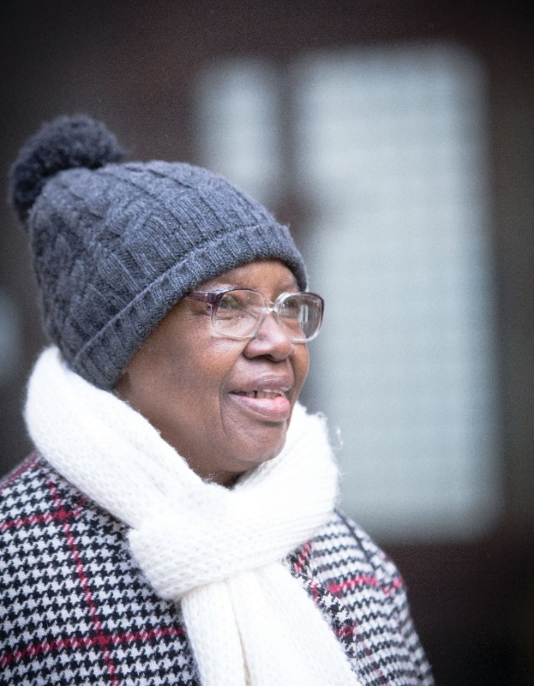
Who have we spoken to?
Online survey promoted through Age UK networks (Jan - Feb 2021)
14,840 responses (incl. 13,189 older people & 1,651 family/informal carers)
Representative online polling with 1,400 older people aged 60+
Ethnographic research with older people who are ‘socially excluded’ and professionals providing specialist support
Notes:
We have conducted a wide range of research but the thread of challenges in accessing primary care has run throughout them all.
By socially excluded we are talking about older people who are homeless, living with drug or alcohol addiction, living in poverty, former prisoners, and older people with severe mental illness

Slide 3
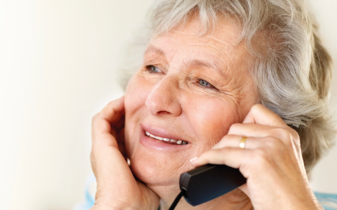
Older people’s experience of primary care during the pandemic

Slide 4
Challenges in accessing a GP
Some older people have faced long and frustrating waits on the phone or have needed to navigate confusing online forms.
Some older people are also wary of the cost of waiting on the phone for long periods of time.
This has resulted in older people delaying accessing the care they need
"Difficulty contacting GP, stuck in long queues, getting cut off and when eventually getting through, being told it's too late to request a ring back by doctor."
"Almost complete barrier to face to face appointments with GP surgery. Have on several occasions waited for about 60 minutes to get phone answered.“
“It is difficult to contact my health centre, if I ring them I receive a recorded message. It is possible to make an appointment via their web page, but it is difficult.”
Notes:
Heard from older people who get up at 8 to get on the phone but already find they are too late or who are spending up to an hour on hold and end up giving up.

Slide 5
Remote appointments work well for some
“Phone consultations with GP. It was good and he followed up. He reassured me that he was just at the end of the phone and he was.”
“Every experience has been top notch. Best of all I got a call back from my GP within a couple of hours at the most.”
“Phoned doctors and got telephone appointment same afternoon and prescription issued immediately and sent straight to chemist. Was able to collect same evening.”
Some older people have appreciated the remove to remote appointments, particularly in the context of the pandemic.
Those who frequently attend appointments have reflected on the convenience of being able to do so from home.
They also explained that it was quicker for them to speak to someone over the phone than it previously was to book a face-to-face
Notes:
Important not to presume that all older people will be against remote appointments as that isn’t the case.

Slide 6
But they are causing difficulties for others
Older people told us the challenges they faced with telephone appointments, including not being able to explain the problem or doctors being unable to examine them.
The system does not always work well, with phone calls not happening at the agreed time, or sometimes not happening at all.
OIder people with hearing or communication difficulties feel excluded from accessing health care
“Unable to actually "see" a doctor - talking on the phone does not let the doctor see all of the "picture“.”
"Waited 3 weeks for a phone call from doctor. She did not phone at appointment time, and I missed the call at an unknown time. I am too stressed & depressed to struggle to get through to GP surgery."
"Only my Audiology service has SMS for people with Hearing Impairment, all others expect me to be able to lipread on the phone."
Notes:
People feeling like they aren’t honest over the phone or can’t communicate as well.
Fears around misdiagnosis
Older people with hearing and communication difficulties, cognitive decline etc.

Slide 7
Inappropriate use of remote appointments
"GP refused to see me face to face and that was what I needed as the Consultant who removed a cancerous growth from my nose told me I needed to have it checked and the dressing changed. I did it myself in the end."
"If you need to see a GP they will offer a telephone consultation. In my case the consultation resulted in my being prescribed the wrong medication.“
We have heard examples of older people being refused face-to-face appointments when they have been needed, for example when dressings have needed changing or for tests.
Some older people feel that remote appointments have led to poor care, including misdiagnosis or being prescribed the wrong medication..

Slide 8
Online systems are a barrier for many older people
E-consultations and video appointments cause challenges for older people with limited digital skills or lack of internet access
Older people also told us how hard they have found being asked to take and send photos to their doctors.
This has led to some older people giving up and avoiding contacting their doctor
"They required photos of the affected area. I found this extremely difficult to carry out and the doctor then complained about the quality. I have not bothered again."
"Surgery prefers online contact. Not possible without frustration and stress.“
“All contact is preferred to be done via their website and/or the NHS. I cannot put the app onto my phone.”
Notes:
Some older people have digital skills but they are quite limited, for example they are able to send emails but wouldn’t be able to do an e-consult.
Many don’t have the most up-to-date equipment, for example they will have a mobile but won’t have the internet on it.
We have also heard of older people being asked to take photos in distressing circumstances, for example being asked to send a picture of their cancer

Slide 9
The experiences of older people who are socially excluded

Slide 10
Digital exclusion amongst socially excluded older people
Older people who are socially excluded are also more likely to be digitally excluded
Former prisoners may be unaware of technological developments or have restrictions on their internet use
Some older people are unable to afford mobile internet or devices
Homeless older people may struggle to access plugs to charge devices
“Technology has moved on and if they’ve never had access to that or learned it in prison what chance have they got in the community.” (User Voice, older former prisoners)
“A lot of our older people, they don’t go online. “It’s all very well saying, well, there’s libraries out there, you can access that for free, but if you’re housebound, you know, you can’t do that.” (Age UK Sheffield)
“I can’t afford mobile internet. I’d like it, if I had more money. I get £73 a week in total.” (Stuart, 56)

Slide 11
Impact of digital exclusion on health
Lack of access to health information and awareness of health services
Difficulty engaging with services means people give up. This can lead to older people reaching crisis point
“A lot of them will come out to the community and they won’t know what’s available to them. I think very few probation officers are actually signposting various older men and women they’re working with to age specific support.” (RECOOP, older former prisoners)
“I contacted the GP as I have a list of things that I wanted to check in about, but they told me the only way was to go online. I can’t do that…there’s no way around it for me.” (Nehala, 60)
“A lot of them get to the point that, when they do need health care, it’s A&E.” (Single Homeless Project, older homeless people)
Notes:
Lack of digital skills makes it harder for older people who are socially excluded to access health information or know what services are available. This is particularly difficult for people who are socially excluded for a variety of reasons. They are less likely to have friends/ family who can tell them about available support. If they’ve just come out of prison for example they are unlikely to know what support is available. This included a lack of information about how to look after yourself during the pandemic due to no internet access.
We can tell people about things, and they’ve got no clue these things even exist. I don’t know how many people have said to me, thank you so much, I didn’t know about any of this. I would never have known about it if it hadn’t been for you, you know.”

Slide 12
Specific challenges of remote appointments
Older people who are socially excluded are more likely to be living with long-term conditions or cognitive impairment.
Lack of trust in services means continuity of care is vital, yet older people are often unable to speak to the same person each time.
“Those that have been incarcerated for long periods of time, or have lived hard and fast, or have had difficult period of times they tend to present with ailments far faster than those in the community.” (RECOOP)
“In doctor’s surgeries now, you can have appointments over the phone…you get told the information over the phone. However, that needs to be followed up…This group, especially those with cognitive impairment, are going to struggle to retain the information.”
Notes:
More likely to be living with long-term health conditions or cognitive impairment which makes remote appointments more challenging. They are also more likely to be experiencing these issues at a younger age so it isn’t always picked up that they need more support.
“There needs to be continuity. So that people can actually see the same doctor, the same nurse on a regular basis, with pre-arranged times.” (King’s College Hospital Homelessness Unit)

