Slide 1
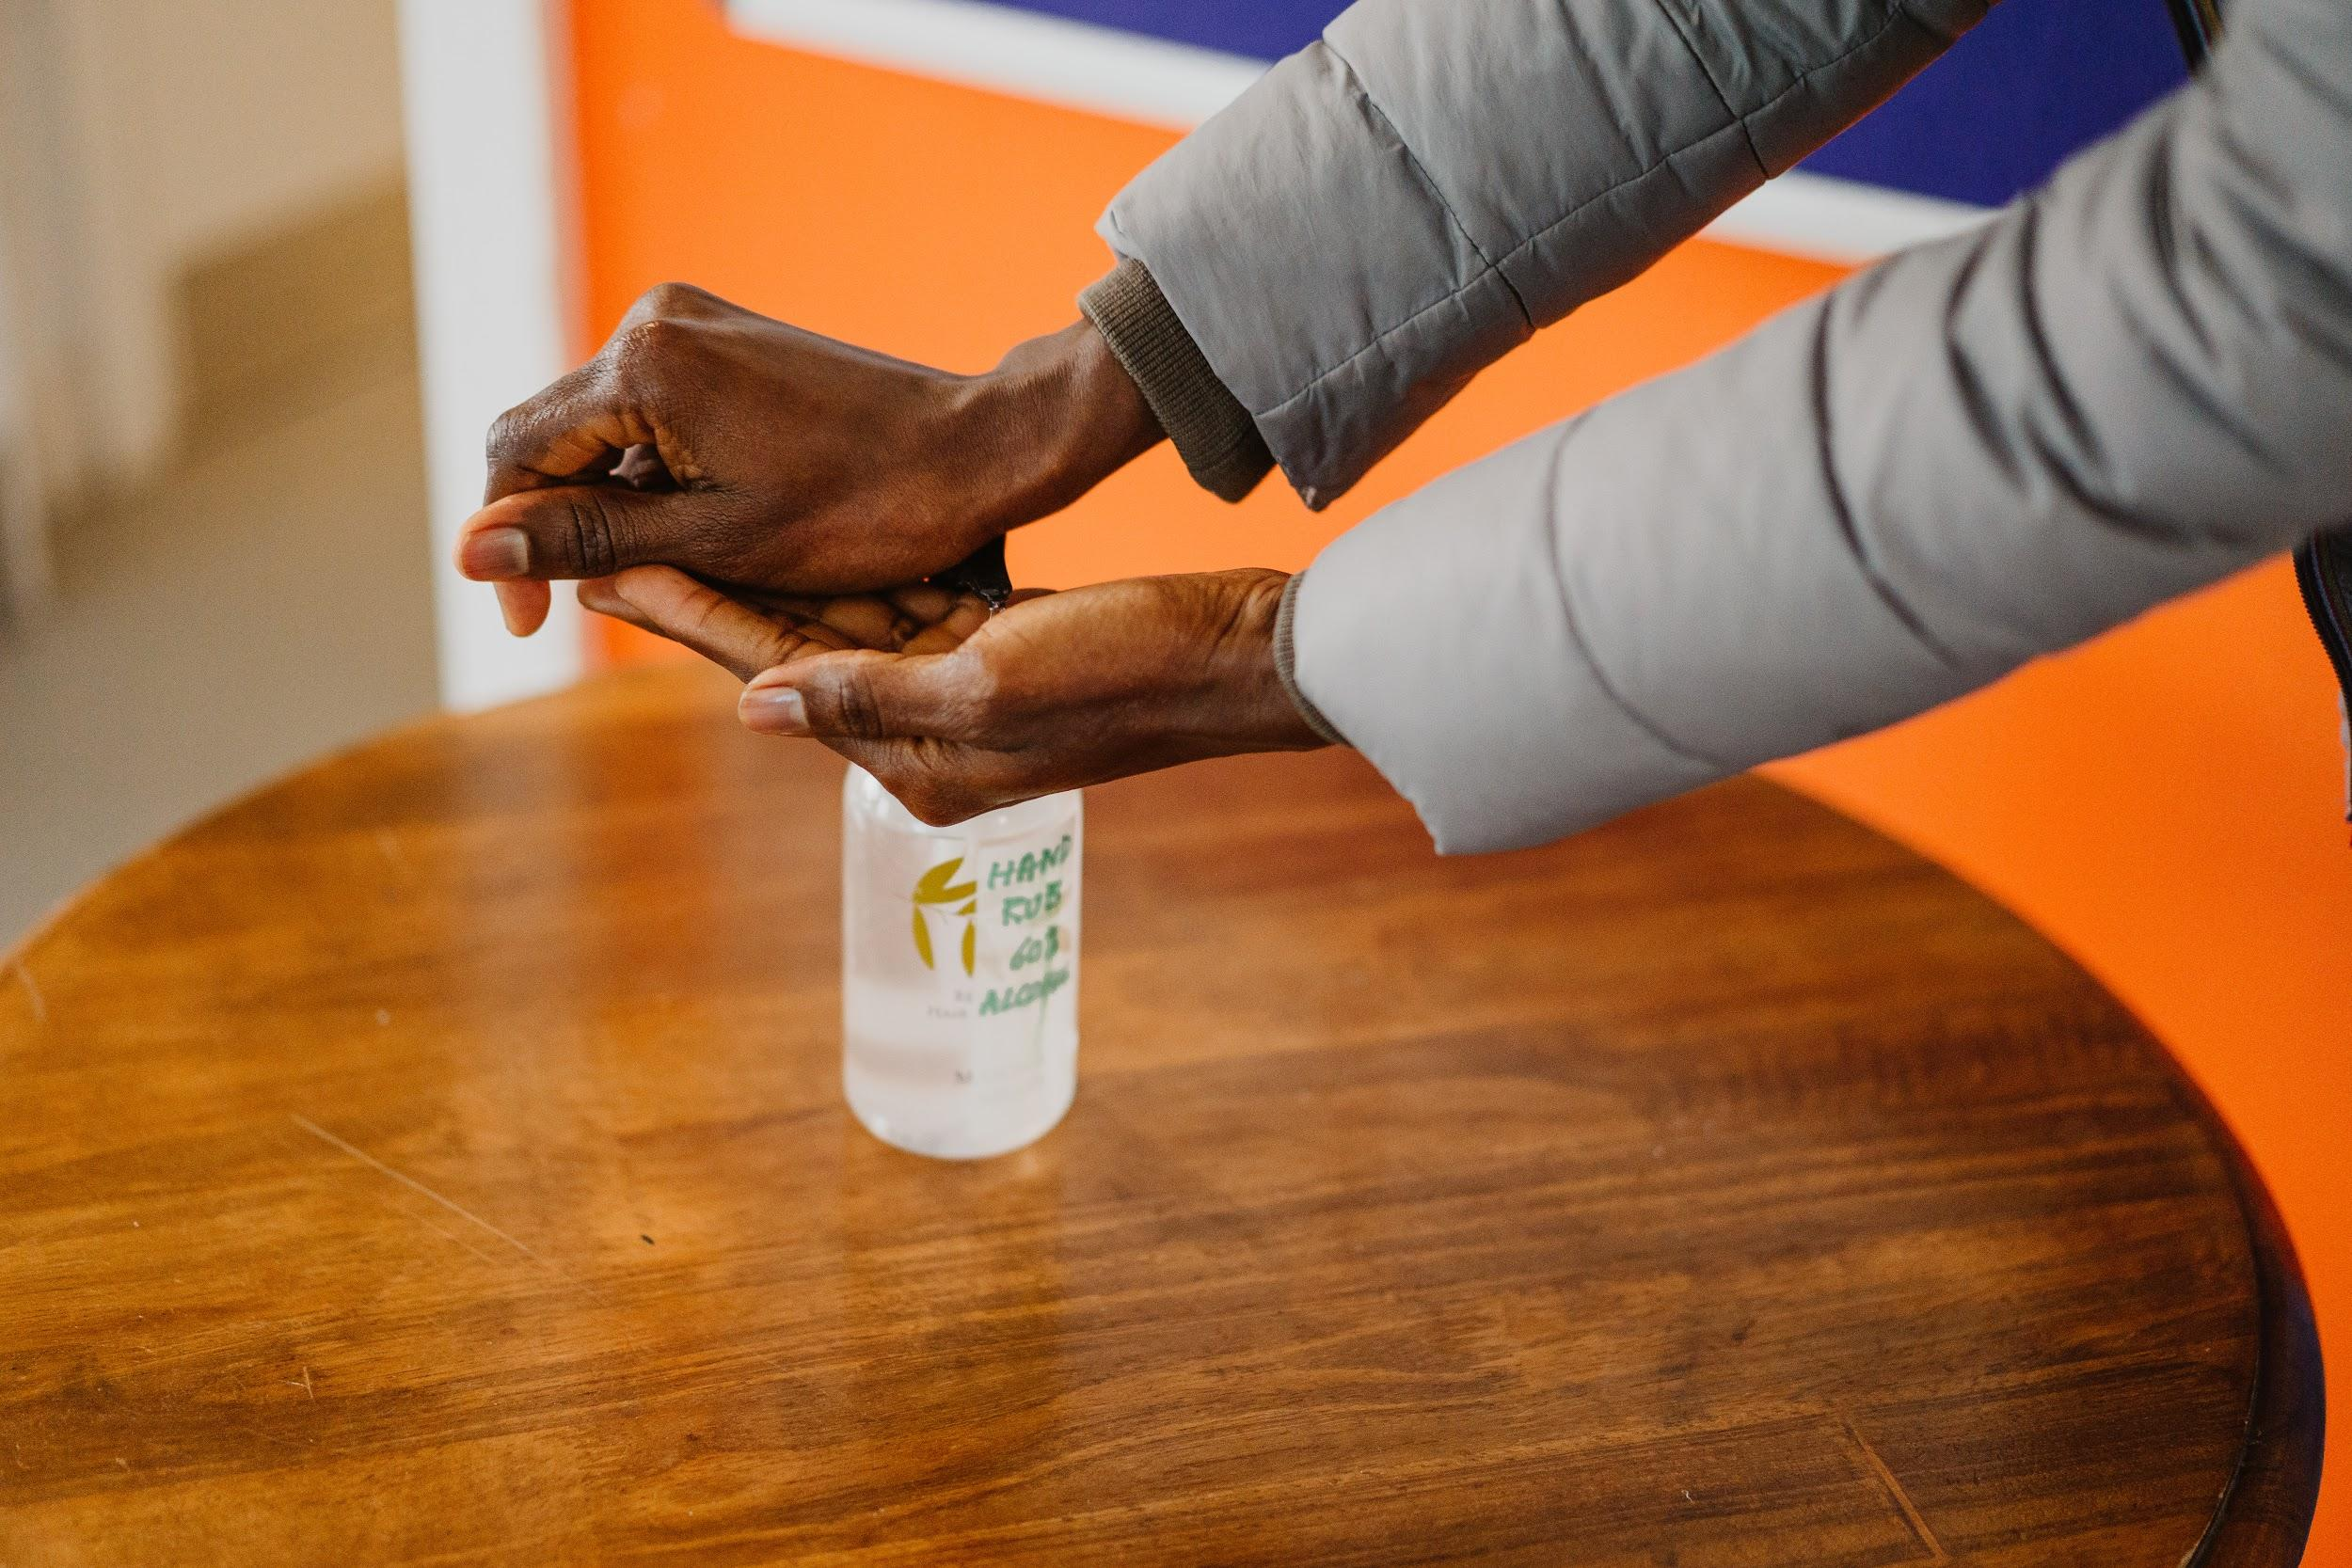
Digital divides and health services
Dr Al Mathers @Al_Mathers

Slide 2
Good Things Foundation
Good Things Foundation is a digital inclusion charity
Our vision is a world where everyone benefits from digital
We’ve supported over 3.6 million people since 2010, 2.9 million of whom are socially excluded
We work with 1000s community partners across the UK and in Australia

Slide 3
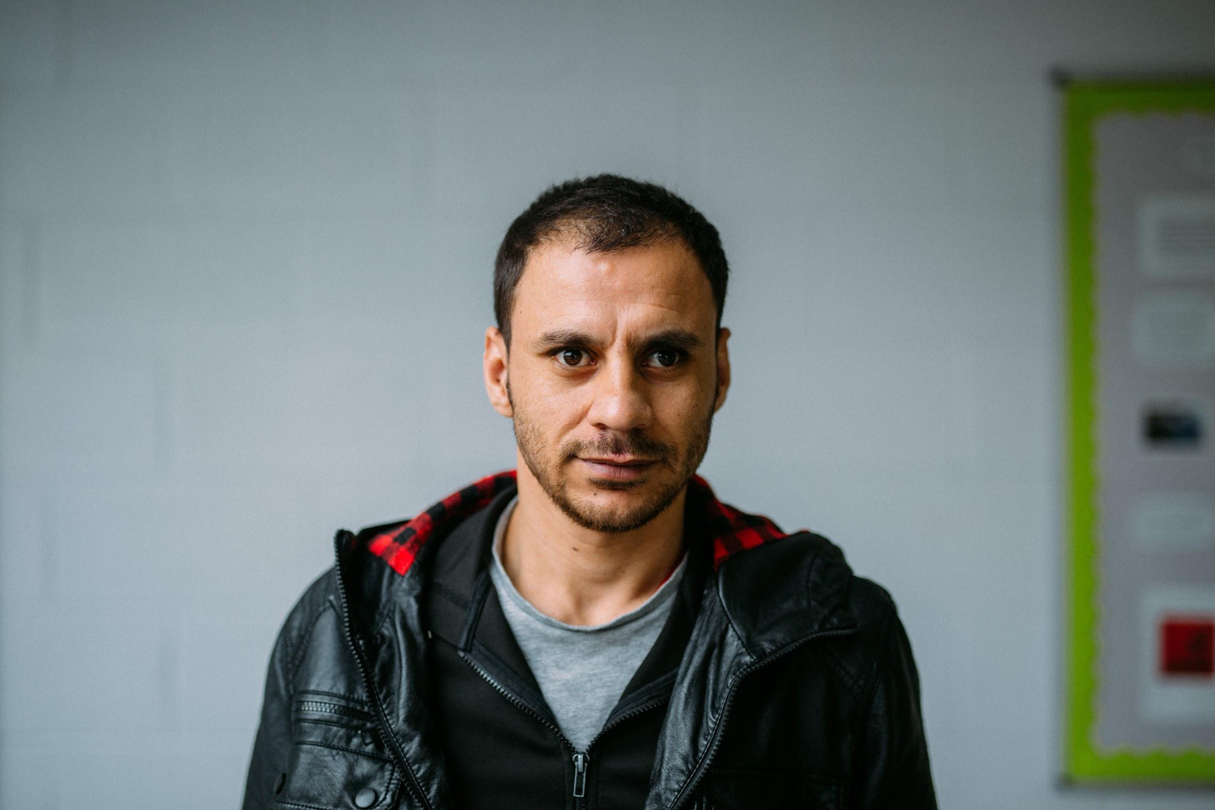
In the UK
2.6 million people are still offline
1.5 million households have no internet access

Slide 4
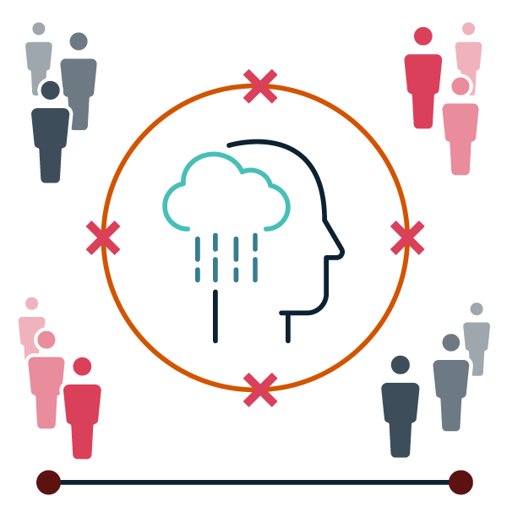
Digital inclusion is having
Access + Skills + Motivation

Slide 5
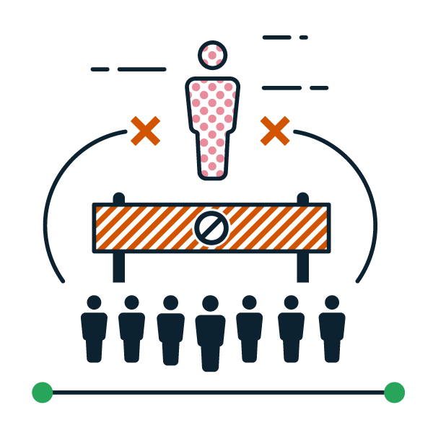
COVID-19 and the digital divide
Economic
Jobs
Education
Social
Participation
Communities
Health
Care
Wellbeing
Money
Benefits
Payments

Slide 6
Lack of personal access
6% of households were without access to internet and devices in March 2021*
Cost is a big problem
Data poverty
Lack of suitable devices
10% of internet users only use a smartphone to get online
*down from 11% in March 2020

Slide 7
Lack of digital skills
2.6 million people (5% of the population) are still offline.
10% of these people are under 50.
55% of those offline earn under £20,000.
A further 20.5 million adults have low or very low digital engagement.

Slide 8
Lack of motivation
Nearly half of those offline say this is due to a lack of interest, up 11% in a year.
Key reasons for not having access include the internet being too complicated (46%), not interested or needed (42%) or too expensive (36%).
Internet security related concerns have all significantly increased.

Slide 9
Limited Users
Those most at risk of digital exclusion are:
Are older 65+ (18%)
From DE households (11%)
More financially vulnerable (10%)
Often left education earlier
Live in rural locations
Live with a health condition or disability
Are social media only users

Slide 10
Why does this matter?
Government services are going online e.g. health, benefits and tax
Further services are going online e.g. utilities, banking, shopping
Jobs are predominately advertised online
Digital skills will be key in the future of work

Slide 11
Digital & health

Slide 12
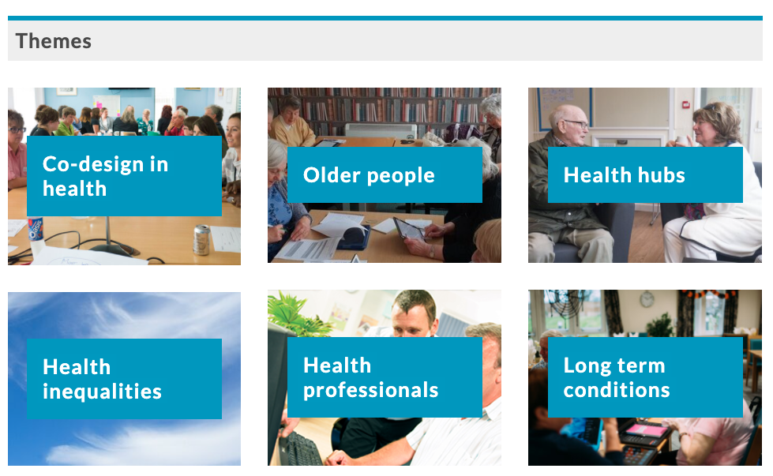
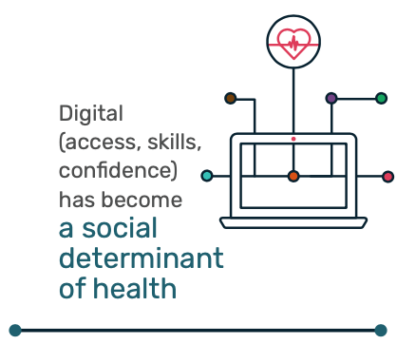
www.digital-health-lab.org
Notes:
NHS WDP - lessons learned report has already been circulated in advance - findings from the second phase (2017-20, concluded as lockdown started), and brings in some findings from the first phase (2013-16). Encourage you to look at the Digital Health Lab website - which features evaluation reports, how to guides, case studies from the 23+ pathfinders - themed.

Slide 13
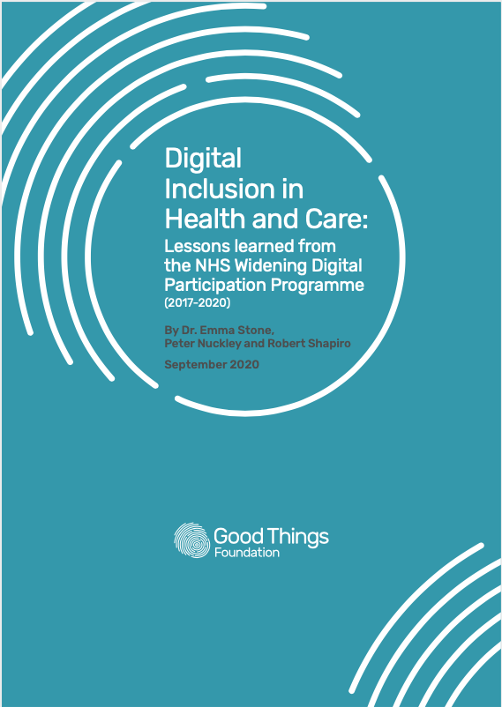
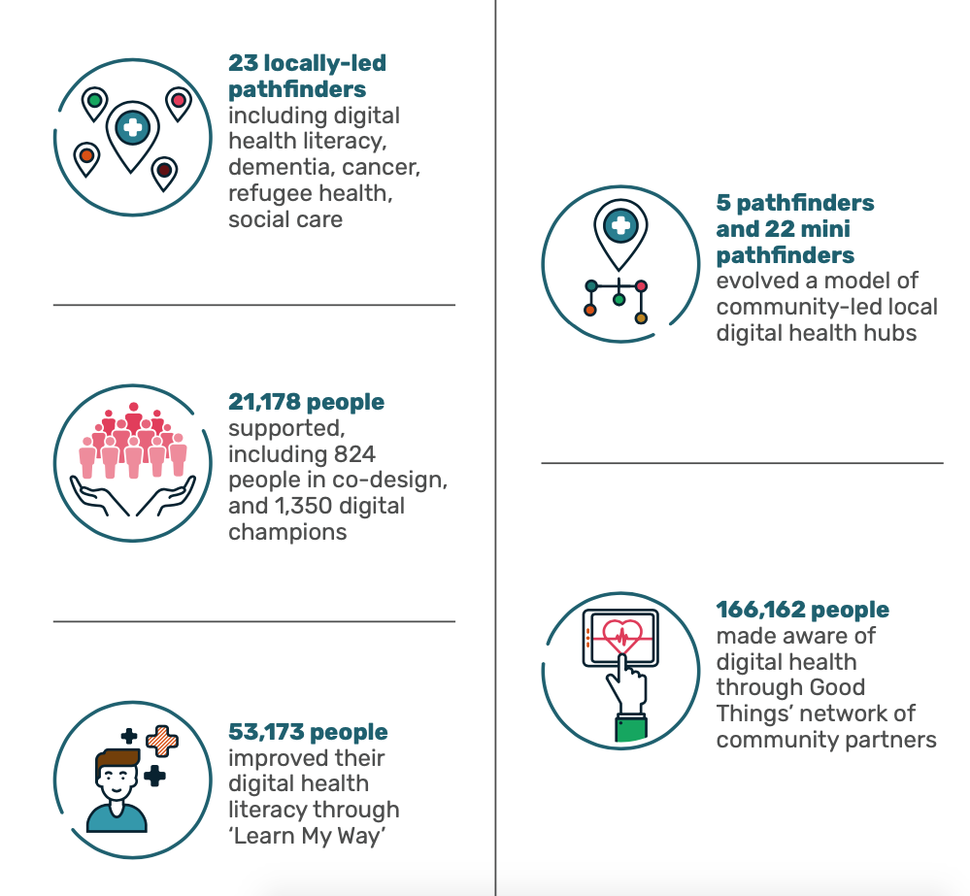

Slide 14
Lessons learned
Recognise digital access & skills as a social determinant of health
Co-design digital health services
Improve digital health literacy in the population
Develop ‘digital health hubs’ to improve inclusion
Build trust & relationships with poorly-served groups
Harness the benefits of digital for health & wellbeing
Improve digital skills in the health and care workforce
Embed digital inclusion in health and wellbeing strategies

Slide 15
Joined Up Recommendations:
Healthwatch England & Good Things Foundation
Invest in support programmes to give as many people as possible the skills to access remote care.
Invest in a national, coordinated approach to community based digital health hubs to build people’s digital skills, confidence and trust
Promote the benefits of the internet for all people.
Provide free essential digital skills support prioritising those in poverty.
Enable practices to be proactive about inclusion by recording people's support needs.
Fund holistic approaches that meet wider needs i.e. ESOL and accessibility.
Co-design health services with people with low digital access and skills, and poorly served groups
Commit to digital inclusion by treating the internet as a universal right.
Embed digital inclusion in all local and national services.
Consider digital confidence of your workforce and focus on building this at all levels.
Harness the power of peers to build skills and motivation.

Slide 16
Further reading and links
Digital Inclusion in Health and Care: Lessons learned from the NHS Widening Digital Participation Programme (2020)
Good Things Foundation COVID-19 Response Report (2020)
Good Things Foundation UK Digital Nation 2020
Blueprint for a digitally included nation (2020)
Lloyds UK Consumer Digital Index 2021
Ofcom Adults' Media Use & Attitudes Report 2021

Slide 17
Thank you
Dr Al Mathers
^{alice@goodthingsfoundation.org}
@Al_Mathers

